Slide 1
Entity Framework 4
Lecturer: Ngo Huy Bien
Software Engineering Department
Faculty of Information Technology
VNUHCM - University of Science
Ho Chi Minh City, Vietnam
nhbien@fit.hcmus.edu.vn

Slide 2

Objectives
To use Entity Framework 4 to develop a software application.

Slide 3

Contents

Slide 4

References
Stefano Mostarda et al. (2011). Entity Framework 4 in Action. Manning.

Slide 5


Hello Entity Framework 4 [1]
STEFANO MOSTARDA ET AL. (2011). ENTITY FRAMEWORK 4 IN ACTION.
FOREWORD
CHAPTER 2. GETTING STARTED WITH ENTITY FRAMEWORK

Slide 6
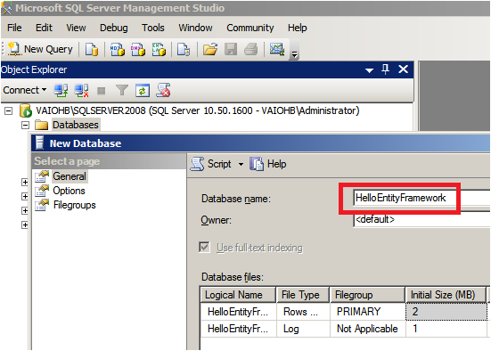
Creating Empty Database

Slide 7
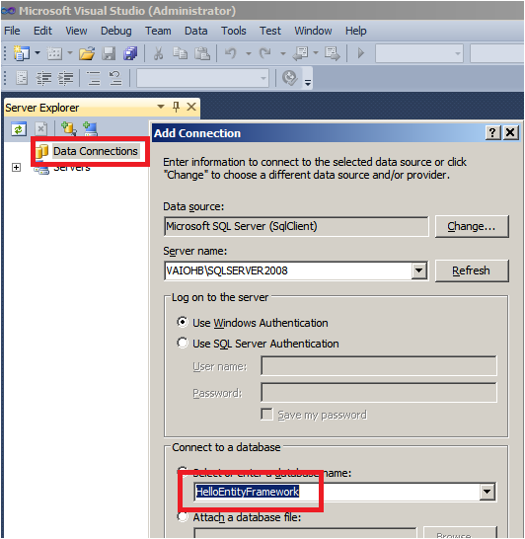
Adding Connection

Slide 8
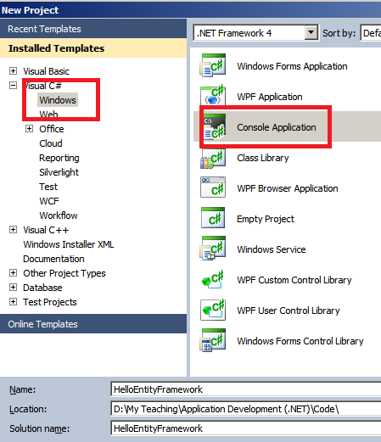
Creating Console Application

Slide 9
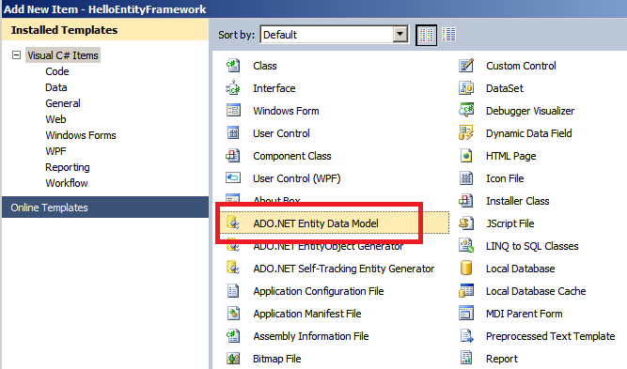
Adding ADO.NET Entity Data Model

Slide 10
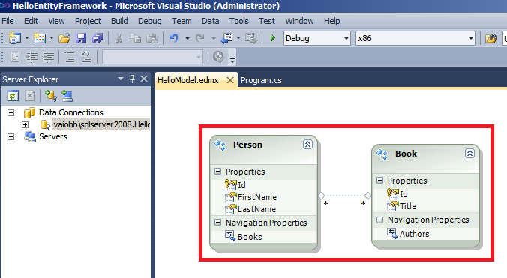
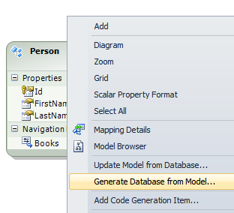
Creating Class Model

Slide 11
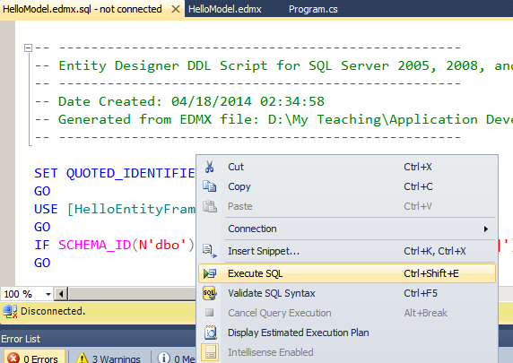
Executing SQL

Slide 12
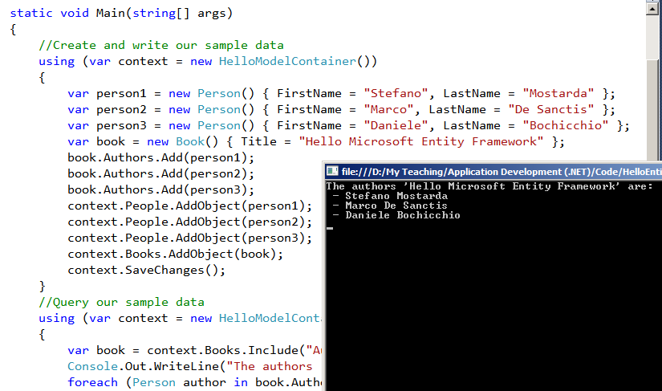
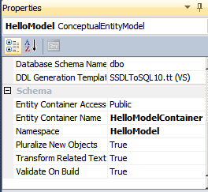
Adding Code and Executing Program

Slide 13
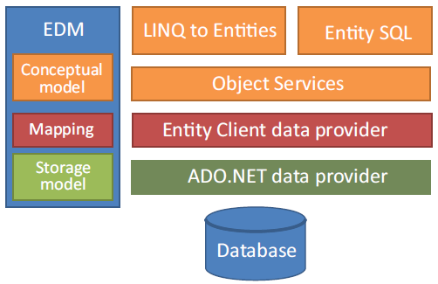
Entity Framework Architecture
The query languages lie on top of Object Services, which relies on Entity Client to interact with the database.
Entity Client uses the standard ADO.NET providers to physically communicate with the database.
The EDM is a layer that’s referenced by all the others and is used by them to obtain metadata about classes.

Slide 14

Thank You & See You Again

